Slide 1
Research Methodology CS 5001 Instructor: Dr. Ramoza Ahsan

Slide 2
Sampling Methods

Slide 3
Sampling Methods
Sampling methods are ways to select a sample of data from a given population (every individual in the whole group).
It is unrealistic to collect data from the entire population because it:
is too big
takes too much time
costs too much money
We therefore take an appropriately sized sample as a way of representing the population.
Depending on the situation, some sampling methods will be more suitable than others. Whichever sampling method is used it is important to justify why that method has been used.

Slide 4
Types of Sampling Methods
1. Probability Sampling
2. Non-Probability Sampling
Notes:
https://www.geeksforgeeks.org/non-probability-sampling/

Slide 5
Probability Sampling
a method of systematic and structured sampling of a sample from a larger population in research and data analysis
makes sure that every individual or element in the population has an equal and fair opportunity to be selected in the sample
Using a strategy based on probability theory, a researcher selects samples from a broader population using probability sampling

Slide 6
Random Sampling
Every item has an equal opportunity of being picked without their being any impact on others following them.
Example: Imagine you are a quality control manager at a chocolate factory, and you want to test the quality of chocolate bars.
You assign a unique serial number to each chocolate bar, and then you use a random number generator to select 20 chocolate bars from the entire production. This ensures that each chocolate bar has an equal chance of being tested.
Notes:
The selection is like picking a name out of a hat.
Simple random sampling is the most basic and straightforward method

Slide 7
Systematic Sampling
It involves selecting every nth item from a population.
For example, if you have a list of students and you select every 10th student, that's systematic sampling.
If you are running a customer feedback program for a retail store with a daily footfall of 300 customers, you can select a systematic sample by choosing every 10th customer as they enter the store.

Slide 8
Stratified Sampling
It divides the population into subgroups or strata based on certain characteristics (e.g., age, gender), and then samples are randomly selected from each stratum
Example: Let's say you are conducting a survey on smartphone preferences. You divide the population into strata based on age groups: under 18, 18-35, and over 35. Within each stratum, you randomly select a sample of individuals.

Slide 9
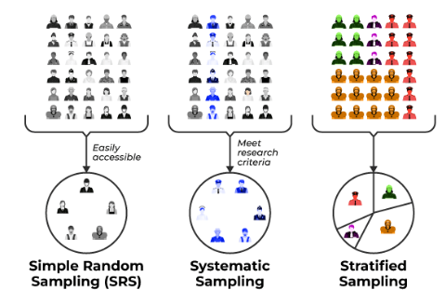
Probability Sampling

Slide 10
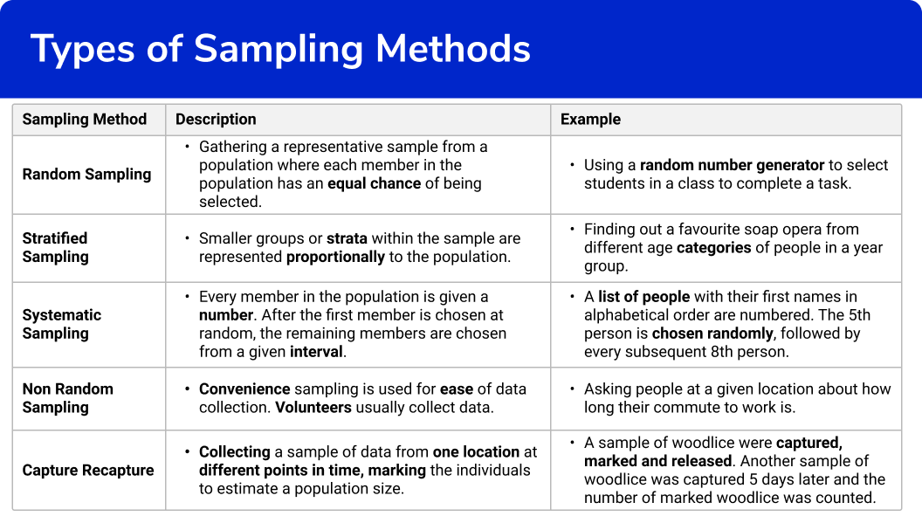

Slide 11
Benefits of Probability Sampling
Reduced bias: helps to reduce bias in the sample by ensuring that everyone has a chance of being selected.
Statistical validity: allows researchers to make inferences about the population based on the sample results.
Increased transparency: more transparent than non-probability sampling methods. This is because the selection process is based on random chance, which can be easily verified.
Ability to calculate sampling error: allows researchers to calculate the sampling error, which is the difference between the sample results and the population results. This information can be used to determine the confidence level of the results.
Increased confidence in results: researchers can be more confident that their results are accurate and can be generalized to the population as a whole.
Notes:
This is especially important when the population is large and diverse.

Slide 12
Non-probabilistic Sampling
Non-probability sampling is a method of selecting a pattern from a population in a manner that does not involve random choice.
depend on subjective judgment, convenience, or different non-random strategies to pick participants
usually used in conditions where random sampling can be tough, impractical, or high-priced, consisting of qualitative studies
can introduce bias into the sample
Notes:
https://www.geeksforgeeks.org/non-probability-sampling/

Slide 13
Convenience sampling (or haphazard sampling)
Researchers choose members based on their accessibility and proximity, making it convenient to collect information
For example, surveying humans at a shopping center or a nearby park would be considered a convenience pattern.
While this method is simple to implement, it frequently outcomes in a biased sample, as it may not represent the complete population.

Slide 14
Judgmental or Purposive Sampling
researchers handpick individuals who they consider are the maximum applicable or knowledgeable approximately the study topic
frequently utilized in qualitative studies
can introduce researcher bias and may not be appropriate for generalization.
Example: Suppose a researcher is conducting a study on the performance of top-performing employee in a big company. Instead of choosing employee randomly, the researcher chooses to interview employee who have acquired a couple of awards and recognitions for their terrific work.

Slide 15
Snowball Sampling
usually used while the target population is hard to reach, which include hidden or marginalized communities.
A researcher begins with some initial individuals after which asks them to refer others who match the studies standards
valuable for analyzing small, elusive populations however may suffer from chain-referral bias

Slide 16
Quota Sampling
entails dividing the population into subgroups or strata and then putting a quota for each subgroup
Researchers acquire records from individuals within every subgroup till the quota is met
it does not assure representativeness and can lead to selection bias if the quotas are not carefully designed

Slide 17
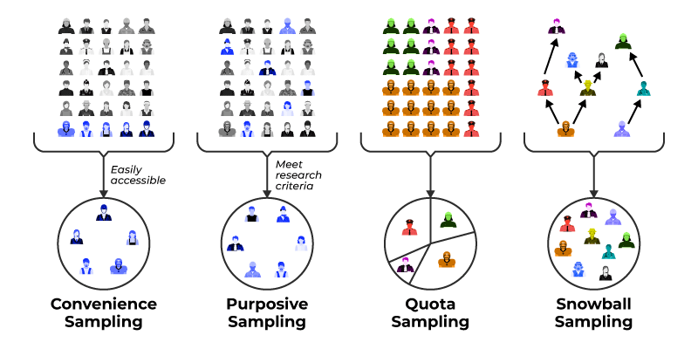
Non-probabilistic Sampling

Slide 18
Limitations of Non-Probability Sampling
Bias: Often introduce choice bias, because the sample may not correctly replicate the characteristics of the whole population.
Limited Generalizability: Findings might not be generalized to the wider population, making them less suitable for making population-level inferences.
Subjectivity: It is based on the researcher's judgment and restraint, that could introduce researcher bias into the pattern selection process.
Unknown Error Rates: Unlike probability sampling, which provides known errors rates, non-probability sampling lacks a clear framework for quantifying and controlling errors.

Slide 19
Thank you
Questions?

